Slide 1
VA ENVIRONMENTAL HEALTH REGISTRY PROGRAM
Audrey Osgood
Administrative Officer
Special Programs
Audrey.Osgood@va.gov

Slide 2
SIX VA ENVIRONMENTAL HEALTH REGISTRY PROGRAMS
AGENT ORANGE REGISTRY
AIRBORNE HAZARDS AND OPEN BURN PIT REGISTRY
DEPLETED URANIUM FOLLOW-UP PROGRAM
GULF WAR REGISTRY
IONIZING RADIATION REGISTRY
TOXIC EMBEDDED FRAGMENT SURVEILLANCE

Slide 3
Military Exposures Classifications
PERIOD OF MILITARY SERVICE | AGENT ORANGE | AIRBORNE HAZARDS AND OPEN BURN PIT | DEPLETED URANIUM FOLLOW-UP | GULF WAR | IONIZING RADIATION | TOXIC EMBEDDED FRAGMENTS
1940s to 1950s |  |  |  |  | l
1960s | l |  |  |  | l
1970s | l
1990s |  | l | l | l
2000s To Present |  | l | l | l |  | l

Slide 4
WHAT IS A REGISTRY EVALUATION?
VHA’s Environmental Health Registry Evaluations are voluntary, focused medical evaluations for Veterans who may have been exposed to certain environmental hazards during their military service.
The registry evaluations are:
Free to eligible Veterans (no co-pay)
Registry data helps VA understand and respond to the health problems of Veterans more effectively.
Data collected through participation in a VHA registry could possibly be used to support a benefits claim.

Slide 5
VA Environmental Health Registry Evaluations
The Environmental Health Registry evaluations track and monitor the health of specific groups of Veterans. A Veteran might meet the criteria and be eligible to participate and enroll in more than one registry evaluation and should participate in as many registries as eligible.

Slide 6
Benefits of Registry involvement for both providers and Veterans
Veteran participation in a VHA Environmental Health Registry evaluation is beneficial to both providers and Veterans:
Participating in the registry will create a snapshot of your health from which to measure changes over time. You can discuss your health concerns with a knowledgeable provider during a free, optional registry evaluation.
VA providers will have access to the answers on a registry form in the Veteran’s VA medical record which facilitates any future care a Veteran requires.
The registry exam process serves Veterans by identifying health issues and helping VA better understand the effects of environmental exposures on health, and respond to these health problems more effectively leading to improved health care for all Veterans.
Registries also help to improve existing VA health care programs and advancement of care at VA.

Slide 7
How does a Veteran initiate an Environmental Health Registry Evaluation?
If a Veteran is concerned about their health as a result of potential environmental military exposure:
The Veteran should discuss their concerns with their health care provider; or
The Veteran can contact the Environmental Health Coordinator directly to schedule a registry evaluation.

Slide 8
Agent Orange Registry
Agent Orange was a mixture of herbicides used by the U.S. military from1962 to 1975 to remove leaves from trees that provided cover for enemy forces during the Vietnam conflict. Agent Orange was also used, tested, or stored at some military bases in the United States and other foreign locations.
This Registry is an in-person health examination completed by a local VA Environmental Health Clinician. It includes an exposure history, medical history, physical exam, and any tests if needed. The results are discussed with the Veteran and in a follow-up letter.

Slide 9
Eligibility
Service in Vietnam 1962-1975, regardless of length of time.
Veterans who served aboard smaller river patrol and swift boats that operated on the inland waterways of Vietnam (also know as “Brown Water Veterans”).
Veterans who served in a unit in or near the Korean Demilitarized Zone (DMZ) anytime between April 1, 1968 and August 31, 1971.
U.S. Army and Air Force Veterans who provided perimeter security on the Royal Thai Air Force (RTF bases in Thailand anytime between February 28, 1961 and May 7, 1975).
Army Veterans who have been a member of a military police (MP) unit or assigned a military occupational specialty whose duty placed him or her at or near the base perimeter.
Veterans who may have been exposed to herbicides during a military operation or as a result of testing, transporting, or spraying herbicides for military purposes.
“Blue Water Navy” Veterans who served within 12 miles offshore of the Republic of Vietnam between January 9, 1962 and May 7, 1975.

Slide 10
Gulf War Registry
Gulf War-related exposures from 1990 and on include a variety of potentially harmful substances: pesticides; pyridostigmine bromide (anti-nerve agents); infectious diseases; chemical and biological warfare agents; vaccinations (including anthrax and botulinum toxoid); oil-well fires, smoke, and petroleum; and depleted uranium.
This registry is an in-person health exam by a local VA Environmental Health Clinician. It includes an exposure and medical history, physical exam, and possible laboratory tests if appropriate. (If a Veteran is seen at the VA and has had the appropriate tests done within the past year, a clinician may not order any labs associated with the visit – they may just review the Veteran’s recent tests in CPRS.) The results are discussed with the Veteran and in a follow-up letter and may be useful for follow-up care.

Slide 11
Eligibility
Veterans who served in the Gulf during Operation Desert Shield, Operation Desert Storm, Operation Iraqi Freedom, or Operation New Dawn are eligible for the Gulf War Registry exam.

Slide 12
Airborne Hazards and Open Burn Pit Registry
This Registry is a database of health information voluntarily provided by Veterans and Servicemembers collected on-line through a self-assessment questionnaire that will help VA to collect, analyze, and report on health conditions that may be related to environmental exposures experienced during deployment to countries including Iraq, Afghanistan, and Djibouti since 1990 and may have been exposed to airborne hazards, including smoke from open burn pits (trash fires), oil-well fires, dust and pollution.
Veterans can report exposures to airborne hazards as well as other exposures and health concerns. The Veteran must initiate the process by filling out the on-line questionnaire. After completing the questionnaire, a Veteran can ask for a free in-person medical evaluation at their local VA facility. The Environmental Health clinician will complete a template in the Veteran’s electronic medical record with the results of the evaluation.

Slide 13
Eligibility
Veterans who served in Operation Desert Storm, Operation Desert Shield, Operation Enduring Freedom, Operation Iraqi Freedom, Operation New Dawn, and Operation Freedom’s Sentinel. Veterans and Service members who have deployed to the Southwest Asia theater of operations on or after August 2, 1990 as well as those who have deployed to Afghanistan or Djibouti after September 11, 2001.

Slide 14
Ionizing Radiation Registry
Since 1941, some Veterans have been exposed to ionizing radiation from a variety of sources, including nuclear weapons testing or other activities during service. The examination includes an exposure and medical history, a physical exam, and laboratory tests. The results of the exam may be useful for follow up care or to address future concerns.

Slide 15
Eligibility
On-site participation in a test involving the atmospheric detonation of a nuclear device, ether or not the testing nation was the United States.
Participation in the occupation of Hiroshima or Nagasaki from August 6, 1945 through July 1, 1946.
Internment as a prison of war in Japan during World War II.
Receipt of nasopharyngeal (NP) – nose and through – radium irradiation treatments while the in the active military, naval, or air service.
Involved in the following “radiation-risk activities”:
Service at Department of Energy gaseous diffusion plants at Paducah, KY, Portsmouth, OH, or the K25 area at Oak Ridge, TN, for at least 250 days before February 1, 1992 under certain conditions. Proximity to “Longshot,” “Milrow” or “Cannikin” underground nuclear tests at Amchitka Island, AK, before January 1, 1974.

Slide 16
Veterans with health concerns related to ionizing radiation who do not qualify for this registry, (e.g. Operation Tomodachi, McMurdo Station, Enewetak Atoll clean-up, etc.) are encouraged to discuss their concerns with their primary care provider who may recommend the Veteran to schedule an appointment with an Environmental Health Clinician.

Slide 17
Depleted Uranium (DU)
Depleted Uranium (DU) is a byproduct of the uranium enrichment process used by the U.S. military in projectiles and tank armor during the Gulf War in 1990. It is most hazardous when internalized through shrapnel, contaminated wounds, or inhalation.
VA and the Department of Defense established the Depleted Uranium Follow-up Program at the Baltimore VA Medical Center to screen and monitor Veterans for health problems associated with exposure to depleted uranium (DU). For Veterans involved in friendly fire incidents who had inhalational exposure to DU or who have DU embedded fragments or contaminated wounds, the DU Follow-up Program offers on-going medical surveillance through detailed clinical assessment visits performed at the Baltimore VA Medical Center. For Veterans presenting with concerns or questions about DU exposure during combat, the programs offers screening to assess exposure through completion of a questionnaire and urine testing via mail. Results will be mailed to both the Veteran and the Veteran’s primary care provider, which can inform follow-up care.

Slide 18
Eligibility
VA requires active duty service in any of the following conflicts: Gulf War, Bosnia; Operation Enduring Freedom; Operation Iraqi Freedom; Operation New Dawn. The DU Follow-up Program is especially geared to Veterans who were on, in or near vehicles hit with “friendly fire;” rescuers entering burning vehicles and those near burning vehicles; salvaging damaged vehicles, or near fires involving DU munitions. Any Veteran concerned about possible DU exposure may submit a urine sample to the DU Follow-up program for testing via mail.

Slide 19
Toxic Embedded Fragments
Some Iraq and Afghanistan Veterans were exposed to a blast or similar traumatic incident, which resulted in embedded fragments (also called “shrapnel”) that remained in their bodies. The word “toxic” refers to fragments made from potentially harmful materials used in improvised explosive devices (IEDs), bombs, mines, and shells.
The mission of the Toxic Embedded Fragment Surveillance Center is to offer medical surveillance to Veterans injured by a bullet (or other projectile), blast or explosion who have retained embedded fragments from their injury. The information from the registry will be used to write guidelines for medical care.
For the Toxic Embedded Fragments registry, contact the OEF/OIF/OND Clinical Coordinator at the VA Medical Center in White River Junction to schedule a registry evaluation.
Stephen W. Plumb, LICSW-SUPV, BCD
Transition and Care Management Services
White River Junction VAMC
Office: 802-295-9363 ext. 4709
Stephen.plumb@va.gov

Slide 20
Camp Lejeune
In the 1980s, contaminants were found in several wells that provided drinking water at Camp Lejeune, N.C. The contaminants included the volatile organic compounds trichloroethylene (TCE), perchloroethylene (PCE), vinyl chloride, benzene, and other compounds. The primary sources of this contamination were on-base leaking storage tanks and industrial activities, and an off-base dry cleaner. It is estimated that the contaminants were in the water supply from the mid 1950s until February 1985, when the wells were shut down.
The Marine Corps maintains an information database for those who may have been exposed to contaminants in the drinking water at Camp Lejeune between August 1, 1953 and December 31, 1987. The Marine Corps continues to work diligently to both identify and communicate with registrants by sending them the latest information via mail and email.

Slide 21
To be added to the Camp Lejeune Historic Drinking Water Notification Database or for more information, please visit: http://www.marines.mil/clwater/.
To contact the Camp Lejeune Historic Drinking Water Call Center, please call (877) 261-9782 or e-mail clwater@usmc.mil

Slide 22
The VA does not offer a Camp Lejeune registry. The Camp Lejeune Act of 2012 provides health care and health care funding assistance to Veterans and family members who lived on Camp Lejeune, meet the time-on-station and service date requirements, and have one of the covered conditions.
Veterans, National Guard and reserve members, and family members who lived on the base for at least 30 days (cumulative), between August 1, 1953 and December 31, 1987 are eligible.
Dependent family members of Veterans who also resided at Camp Lejeune during the qualifying period are eligible for reimbursement of out-of-pocket medical expenses related to any of the 15 covered health conditions. (VA can only pay for treatment costs that remain after payment from family member’s other health plans.)

Slide 23
Veterans eligible for health care under the Camp Lejeune Act of 2012 may enroll in VA health care and receive medical services for any of the 15 covered health conditions and eight disability conditions at no cost.
The Department of Veterans Affairs has established a presumptive of service connection for eight conditions associated with exposure to contaminants in the water supply at Camp Lejeune, NC. These are the conditions for which VA has determined, after a review of scientific and medical literature on health effects related to the contaminants of concern at Camp Lejeune, there is sufficient scientific and medical evidence to support presumptive service connection. The VA will continue to review relative information on other conditions as it becomes available. If a Veteran is diagnosed with one of these conditions, VA presumes that the Veteran’s Camp Lejeune services caused the condition, and disability compensation can be awarded.

Slide 24
Resources
Military exposures website - www.publichealth.va.gov/exposures
Airborne Hazards and Open Burn Pit Registry: https://veteran.mobilehealth.va.gov/AHBurnPitRegistry
Technical support for Airborne Hazards & Open Burn Pit registry, Registry Help Desk at 1-877-470-5947 from 8AM to 8PM ET.
Gerard “Rocky” DeCosta
Environmental Health Coordinator
VA Medical Center
White River Junction, VT 05009
802 295-9363, extension 6904
Gerard.DeCosta@va.gov

Slide 25
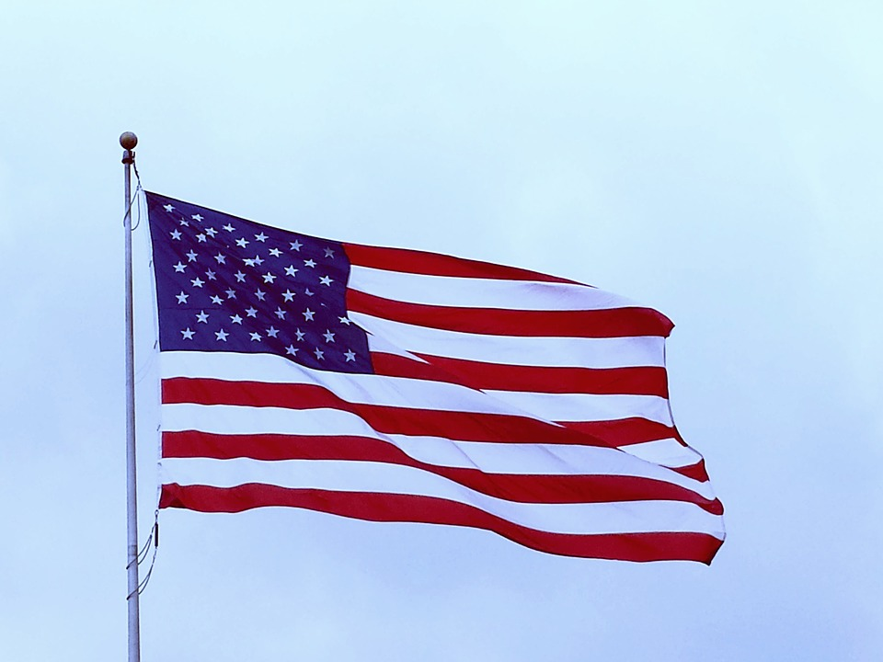
Thank-you for your time and attention!

