Slide 1


Million Veteran Program
MFCN JCF Quarterly Meeting – 10 Jul 2019
R. Brooks Robey, MD FASN FAHA FAPS FNKF FACP AHSCP-CHS
Associate Chief of Staff for Research & Development
Staff Physician & Founding Chief (2009-2014), Nephrology & Hypertension Section
White River Junction VA Medical Center
Associate Professor of Medicine and of Medical Education
Faculty, Program in Experimental & Molecular Medicine
Geisel School of Medicine at Dartmouth

Slide 2
Million Veteran Program
“A Different Type of Blood Drive” – “Precision Medicine”
Goal: Create a world class research database of genetic, military exposure, lifestyle and health information that approved researchers can use to:
  Develop new diagnostic tests to prevent and treat disease
  Develop new drugs based on how disease-causing genes work
  Personalize therapies to the Veteran's individual genetic characteristics and conditions (ex. pharmacogenomics)
  Link military exposures to genetic susceptibilities for novel approaches to these conditions

Slide 3
MVP Enrollment
One-time study visit (~20 min)
  Informed consent
  Blood sample for genetic analysis
  Baseline survey + optional lifestyle survey
Electronic medical records access
Participation voluntary
  Withdrawal permissible at any time
Personally identifiable information protected
  VA Information Security Policies
  NIH Certificate of Confidentiality
  Genetic Information Nondiscrimination Act (GINA)

Slide 4
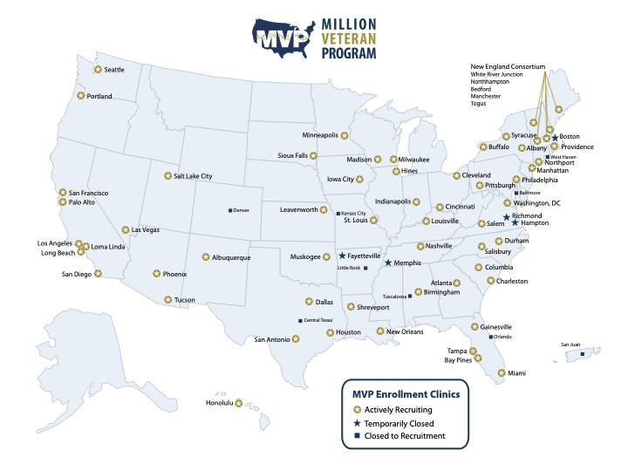
58 Active Sites
77 Sites Total
>750K Enrollees

Slide 5

White River Junction
WRJVA
Burlington CBOC
Bennington CBOC
NNERC Partners
Togus
Manchester
Northampton
(Bedford)

Slide 6
NNERC Program Enrollment

Slide 7

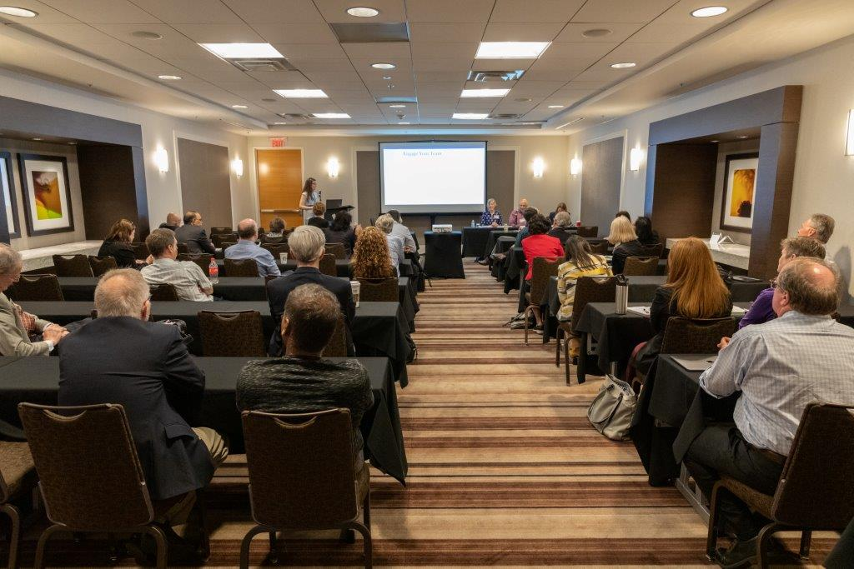
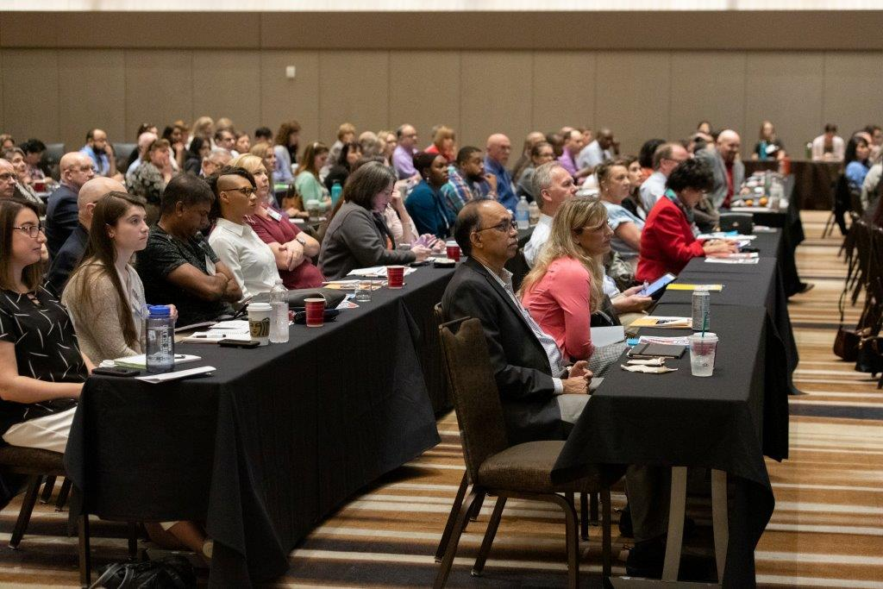
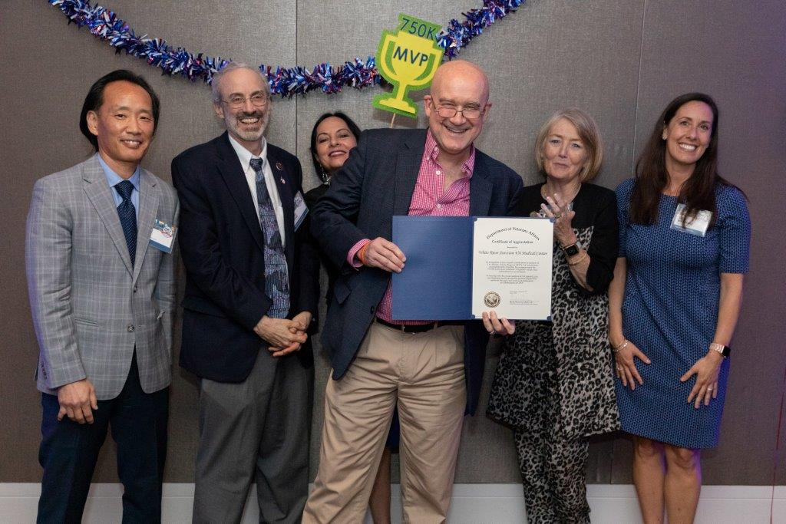
750K And Beyond

Slide 8

MVP Contact Information
WRJVA
802.295.9363
x5991

Slide 9
