Slide 1
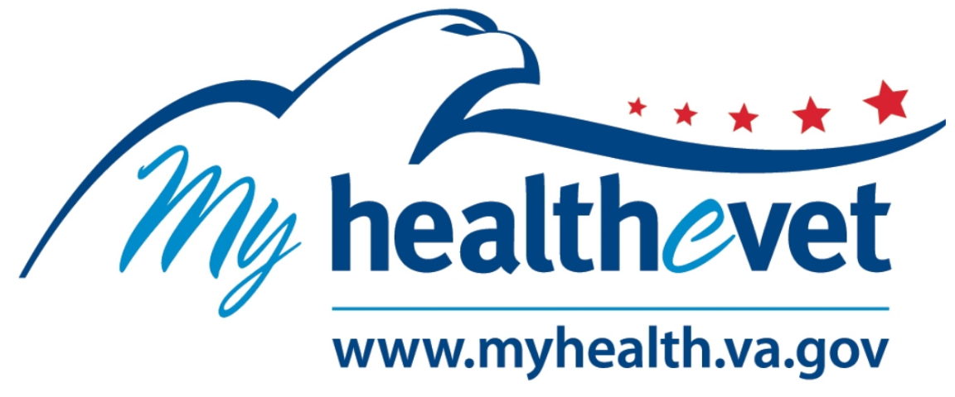

Slide 2
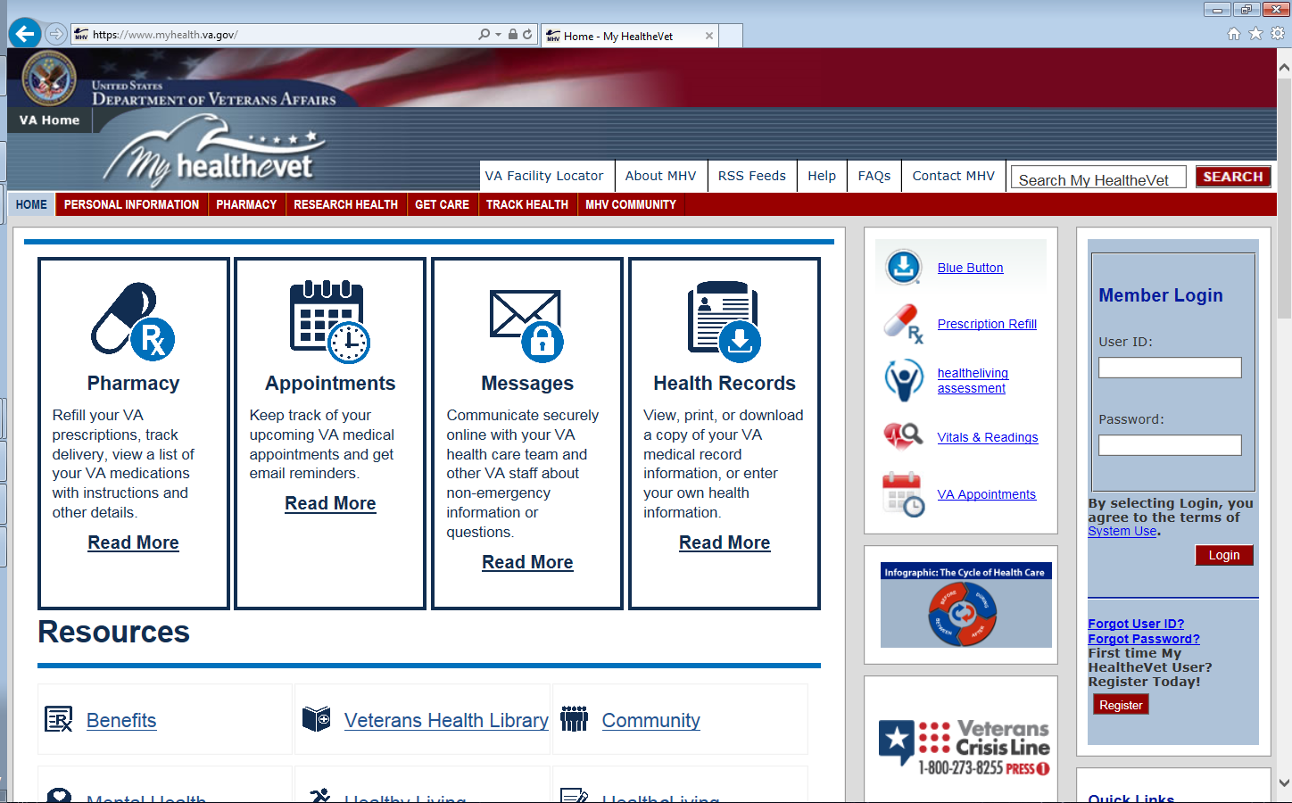

Slide 3
Pros
Cons
Less phone traffic
No waiting in call queue
Less agitated veterans
Quicker access to care
Less advocacy complaints
Cuts out middle-person
Higher patient awareness
Patients manage their care
Hear directly from their PACT
Messages can be sent directly to PACT or Specialty Clinic
MHV will not solve every patient’s problem
Technologically reluctant demographic
We have to sell patients on taking charge of their healthcare
Employee complacency and resistance to change—even if for the better
Culture change

